Slide 1
AOZ Challenge: SupplyHub
Daniel Maksimovic, Katerina Kuneva, Nils Grob (Group 5)
Zürich, 01.11.2025

Slide 2
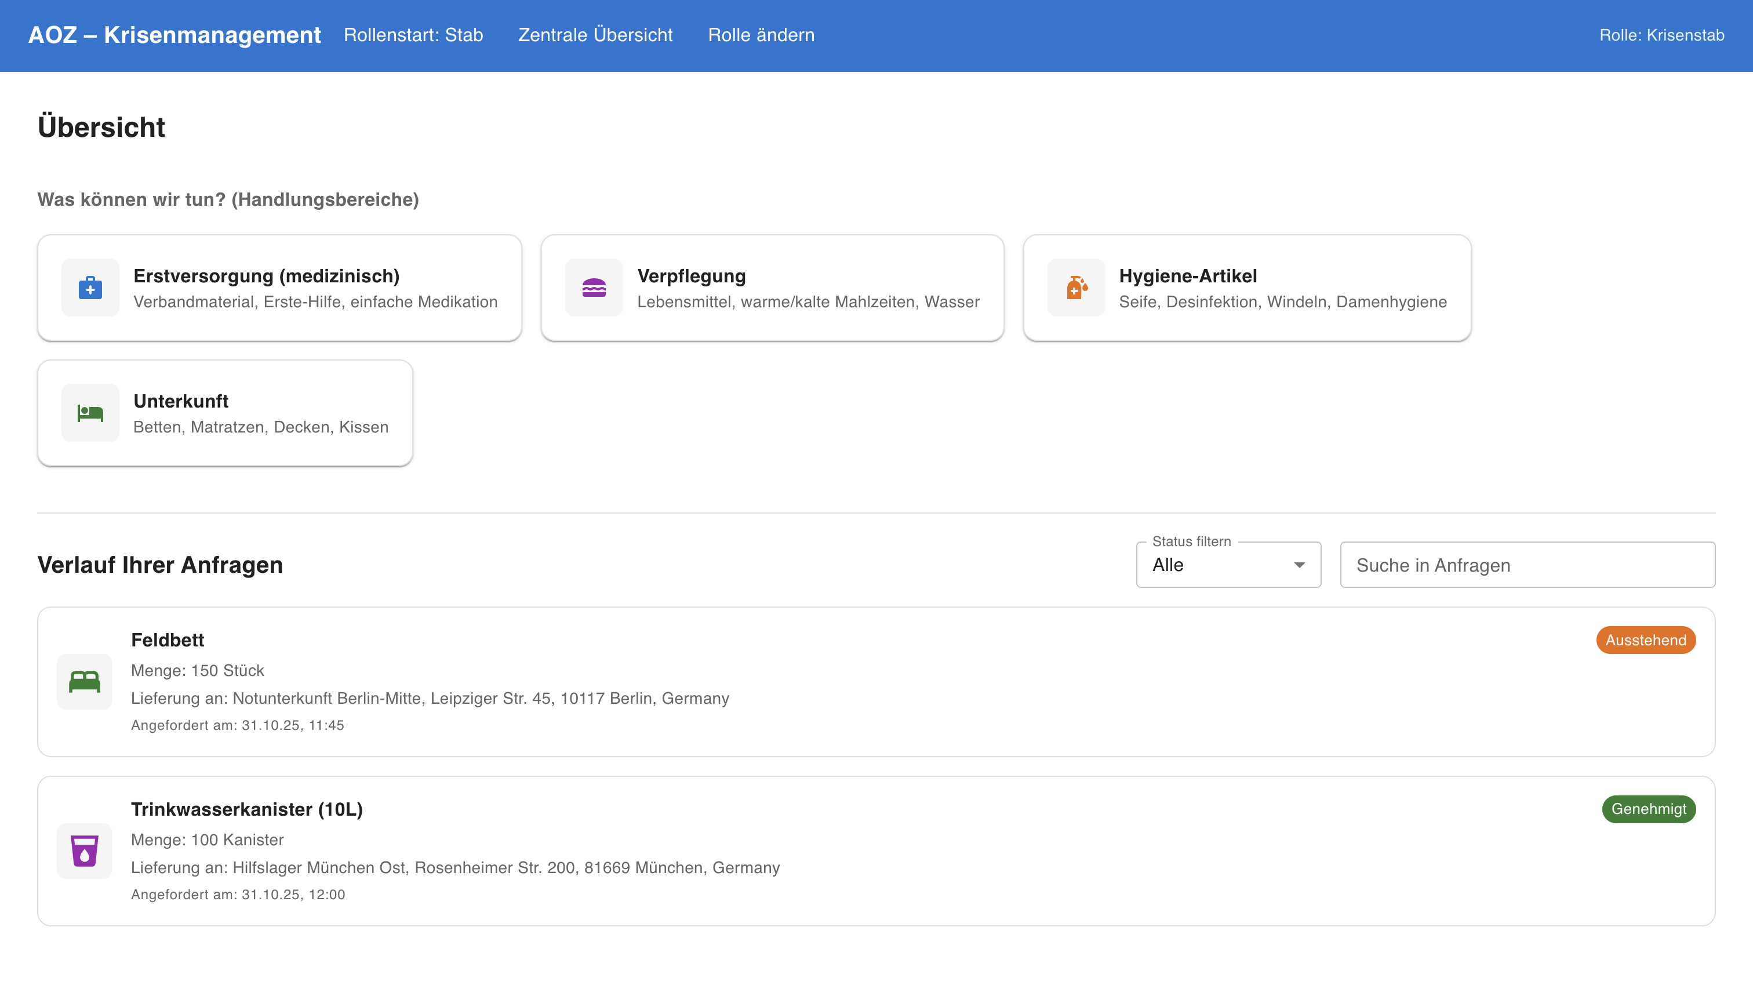

Intro
SupplyHub: a shared, city-wide platform to plan, store, and deploy emergency supplies fast.
Tech Stack: React + Vue (Frontend) & Python (Backend)

Slide 3

Anna’s Challenges
Fragmented Procurement:
Parallel procurement and storage across city actors lead to duplication, higher costs, slow coordination, and last-minute panic buying.
Disconnected Logistics:
Crisis teams and logistics management all need the same emergency goods but lack a shared overview, which causes coordination gaps.
Reactive, not prepared:
As new arrivals flood in overnight, Anna’s team scrambles to respond. Information is scattered, decisions are delayed, and families wait longer for the essentials they need.

Slide 4
Our Solution
SupplyHub: One shared platform to plan, source, store, and deploy emergency supplies across city actors, with role-based access and readiness tracking
Three Core Features:
Stab Dashboard: Overview and action center for the crisis management staff.
Authorization Dashboard: Validation and approval interface for stock requests.
Organisation Dashboard: Stock, logistics, and inspection management for local facilities.

Slide 5
Demo

Slide 6

Impact & Outlook
From Chaos to Organization:
Faster setup of safe housing, fewer panic purchases, transparent coordination across city actors, and higher resilience during spikes.
Built for Cities, Ready for Crisis:
One platform spanning preventive planning and crisis response, aligned with the city’s cross-department model and AOZ’s mission.
Notes:
Hours later, families have shelter, the logistics team has clarity, and Anna — for the first time — breathes out.
SupplyHub turned crisis coordination from a guessing game into a synchronized system.
It gave Anna what every city needs in a crisis: control, speed, and trust.

Slide 7
Why SupplyHub?
Solving coordination gaps before the next crisis
Built for real crisis workflows
Replaces fragmented spreadsheets with a unified platform
Connects all actors: crisis staff, logistics, and facilities in real-time
Prevents duplication, saves costs, and accelerates deployment

Slide 8

Roles in Action
Crisis Management (Stab Dashboard):
Full situational overview, rapid needs assessment, and real-time coordination across departments.
Logistics Management (Organization Dashboard):
Tracks stock, transport, and maintenance to make sure resources reach the right place at the right time.
Authorization Role ( Authorization Dashboard):
Reviews and approves requests based on priority, urgency, and resource availability.

